Slide 1
Treponema pallidum
Mrs. Mamita Khaling Rai

Slide 2
Etiology
T pallidum are gram-negative spirochete.
Slender spiral-shaped, thin and tightly coiled and actively motile.The spirals coils are regular spaced at a distance of 1 micrometer.
T. pallidum stained poorly with the usual bacterial stains. Pallidum name refers to it’s pale staining.
Very delicate and highly susceptible to heat.
Difficult to cultivate in artificial media, but possible by co cultivation with tissue culture cells.
They are causative agent of syphilis.
Natural infection occur only in human beings.

Slide 3
Contd....
T. pallidum has no obvious virulence factors such as toxins, but it produces several lipoproteins that induce an inflammatory immune response.
Others
Endoflagella: They provide motility to the bacteria, thus helping in tissue invasion and dissemination. They are also highly antigenic, stimulating a strong early antibody response.
Outer membrane proteins promote adherence to host cells.
Hyaluronidase
Coating with host cell fibronectin protects against phagocytosis

Slide 4
Antigenic structure
3 types of antigen are seen in treponema
Cardiolipin antigen-against which reagin Ab are produced
A group specific antigen
A species specific polysaccharides

Slide 5
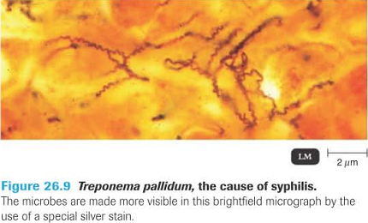

Slide 6
Pathogenesis
Syphilis affects only humans. The disease is normally transmitted by direct contact, in most cases
During sexual intercourse.
Direct contact with lesions containing the pathogens, which then invade the host through microtraumata in skin or mucosa. (through intact or damaged mucosa)
Contaminated needles or blood transfusion (rare)
The incubation period is two to four weeks. The disease progresses in several stages
Infective stage is divided into two stages:-
Early stage: Includes primary syphilis, secondary syphilis and early latent syphilis.
Late stage: Includes late latent syphilis, benign late syphilis, cardiovascular syphilis, and neurosyphilis

Slide 7
Primary syphilis:-
Within about 3 weeks of infection an ulcer, known as a chancre forms at the site of infection usually on the genital area (about 10% of ulcers are extragenital).
The ulcer is shallow, well-defined with indurated edges and a smooth red surface that exudes serum. It is usually painless.
Treponemes can be found in the chancre fluid.

Slide 8
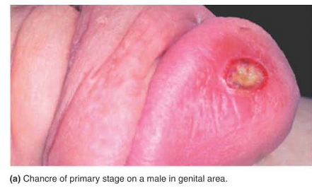

Slide 9
Secondary syphilis
This occurs 4–8 weeks after the primary infection. A widespread non-itchy maculopapular rash appears, corresponding to the spread of organisms in the body.
The secondary skin lesions contain treponemes and are highly infectious.
Treponemes are also present in the blood. Mucous membranes are also infected and mouth ulcers are common.

Slide 10
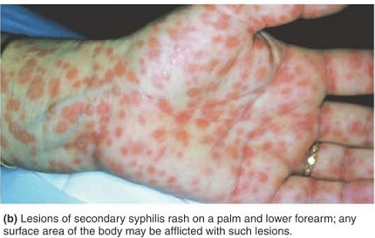
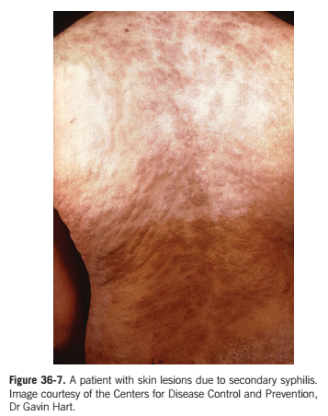

Slide 11
Latent syphilis
During the latent stage, there are no clinical manifestations of syphilis but there is serological evidence of infection.
Latent syphilis is described as early when the infection is under 2 years or late latent syphilis when the infection is more than 2 years.

Slide 12
Late stage syphilis
About 30% of patients with untreated latent syphilis progress to late syphilis, a slowly progressive inflammatory stage in which granulomatous lesions (gummas) develop in skin, bones, liver, stomach and other organs, and degenerative changes occur in the central nervous system causing meningo vascular syphilis, and general paralysis with cerebral atrophy, psychosis and dementia.

Slide 13
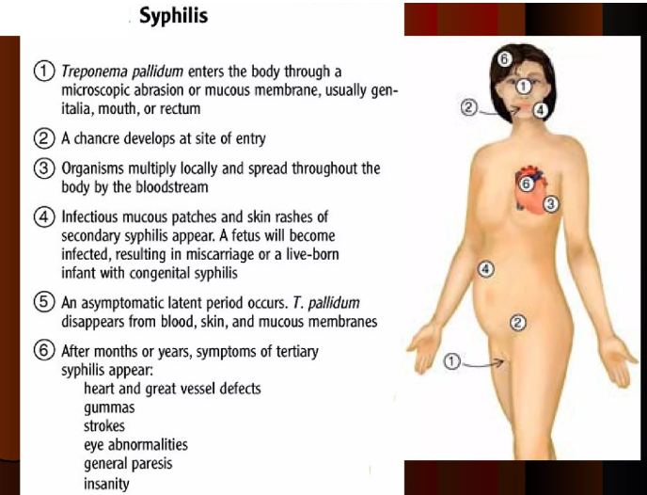

Slide 14
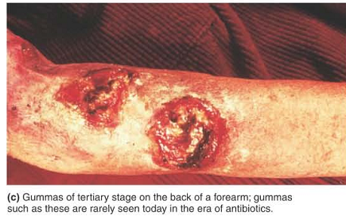

Slide 15
Congenital syphilis.
In few cases, infection during pregnancy can be transmitted to the fetus. This causes congenital syphilis.
Treponemes in the blood pass through the placenta. Syphilis in pregnancy can lead to abortion, premature delivery, stillbirth, perinatal death and the birth of infants with congenital syphilis

Slide 16
Laboratory diagnosis
Specimens: Serous fluid from chancres and secondary skin lesions (from moist areas) to detect motile treponemes.
T. pallidum spirochaetes can be detected during primary and secondary syphilis, infectious relapsing syphilis and early congenital syphilis.
Dark-field microscopy:-A drop of tissue fluids or exudates placed on slide and a coverslip pressed over it to make thin smear and observed under oil immersion (The sensitivity of this test largely depends on proper sample collection i.e obtaining serous exudates from lesions while avoiding blood or pus) followed by placement of collected specimens on a slide and examination within 20 minutes of collection.)
Sometimes silver staining method also used.(usual method for detecting spirochetes in tissue sections)
(Caution: T. pallidum is highly infectious, therefore wear protective gloves when collecting chancre fluid and blood, and ensure preparations are disposed off safely).

Slide 17
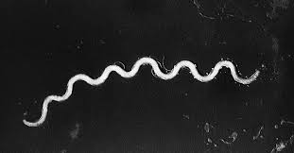


Slide 18
Culture not performed
Pathogenic treponemes have not yet been reproducibly cultured in the routine laboratory. The organisms, however, are able to survive in some fluids, including donated blood.

Slide 19
Serological diagnosis
When skin lesions have healed. Testing a patient’s serum for antibodies is important .
A blood sample (3–5 ml) is required for serological testing.
A person infected with T. pallidum produces two types of antibody.
Non-specific antibody that reacts with cardiolipin antigen in non-specific syphilis tests.
Specific treponemal antibody that reacts with treponemal antigen in specific syphilis tests.

Slide 20
. Non-specific antibody that reacts with cardiolipin antigen in non-specific syphilis tests
Reagin antibody test:-test for antibodies reacting with cardiolipin antigen and are known as Standard test for syphilis. It is nontreponemal tests for syphilis .The term reagin means that this test does not look for antibodies against the bacterium itself, Treponema pallidum, but rather for antibodies against substances released by cells when they are damaged by bacteria(Nontreponemal tests (NTT) measure levels of immunoglobulin G (IgG) and immunoglobulin M (IgM) antibodies produced by the host in response to lipoidal material (mostly cardiolipin) released from damaged host cells. It is also generally believed that some cardiolipin is released by the spirochetes as well)

Slide 21
Wassermann complement fixation test
Khan flocculation test
VDRL/RPR test
screening tests should always be followed up by a more specific treponemal test

Slide 22
Wassermann complement fixation test
Is an antibody test for syphilis, named after the bacteriologist August Paul von Wassermann, based on complement fixation. It was the first blood test for syphilis and the first in the nontreponemal test (NTT) category

Slide 23
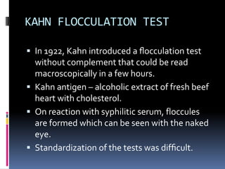

Slide 24
VDRL( Veneral Disease Research Laboratory)
In the VDRL test, heat-inactivated serum (to destroy complement) is reacted with freshly prepared cardiolipin-cholesterol-lecithin antigen and the resulting flocculation is observed.
RPR(Rapid Plasma reagin)
In the RPR test, the cardiolipin-cholesterol-lecithin antigen has choline chloride added to it which removes the need for heat-inactivation of samples and enables plasma as well as serum to be used in the test. It also enhances the reactivity of the antigen.(flocculation)

Slide 25
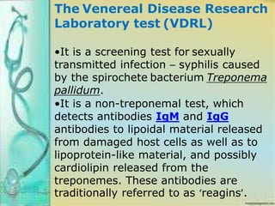

Slide 26
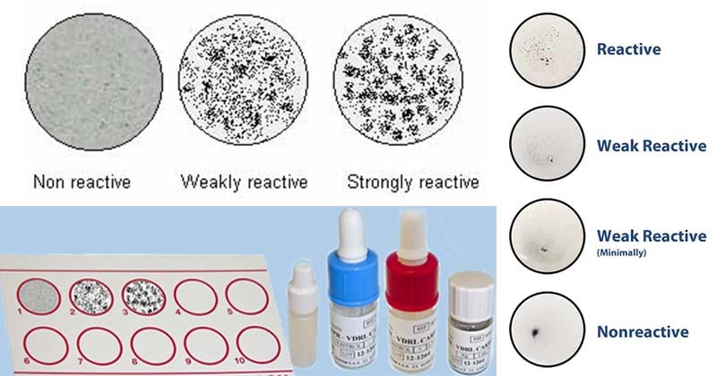
VDRL

Slide 27
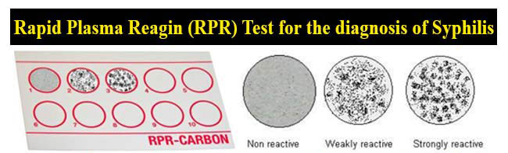

Slide 28
Specific treponemal antibody that reacts with treponemal antigen in specific syphilis tests.
Include:
– TPHA (T. pallidum haemagglutination assay)
RBCs coated with purified Treponema antigens agglutinates when treated with serum containing specific treponemal antibody
– TPPA (T. pallidum particle agglutination assay- detection of antibody)
– FTA-ABS (Fluorescent treponemal antibody)
absorption) test
– Rapid immunochromatographic tests

Slide 29
Diagnosis of congenital syphilis
May be possible to detect motile treponemes by dark-field microscopy.
Specimen:- fluid from skin lesions or nasal discharge (sufficiently thin preparation).
A presumptive diagnosis of congenital syphilis can be made by infant’s serum which gives a reactive specific treponemal antibody.

Slide 30
Treatment
Penicillin is the drug of choice for treatment of syphilis.
For Penicillin resistant tetracycline, azithromycin, doxycycline are effective.

